Slide 1
AG news Classification
1
Ahmed 211392
Sara 212071
Abdulrahman 211896
Ezz 206879

Slide 2
Content
Introduction
Bert
Pre-Processing
Evaluation Metrics
Results
DistilBert (model 1, model 2, model 3, model 4)
Pre-Processing
Evaluation Metrics
Results
Comparison

Slide 3
Introduction
In this project, we used the AG's news topic classification dataset to categorize news articles based on their descriptions using transformers in order to determine their category from the dataset's four categories, which are World, Sports, Business, and Sci/Tech [1]. From model 1 to model 4, we employed DistilBERT transformer, while in model 5 we employed BERT transformer. In addition to that we did 3 incomplete trials of albert model.
Datasets used:
AG news : The AG's news topic classification dataset is constructed by choosing 4 largest classes from the original corpus.
Size: 120,000
Classes: 4 (World, Sports, Business, Sci/Tech).
Models overview: BERT, developed by Google, is a sophisticated language model that learns from vast amounts of text data to understand language patterns. ALBERT, a derivative model, is similar to BERT but engineered to be more compact and computationally efficient while maintaining high performance. DistilBERT, another variant, is like a distilled version of BERT, aiming to retain essential language knowledge while reducing the model size and computational requirements.

Slide 4
BERT Model

Slide 5
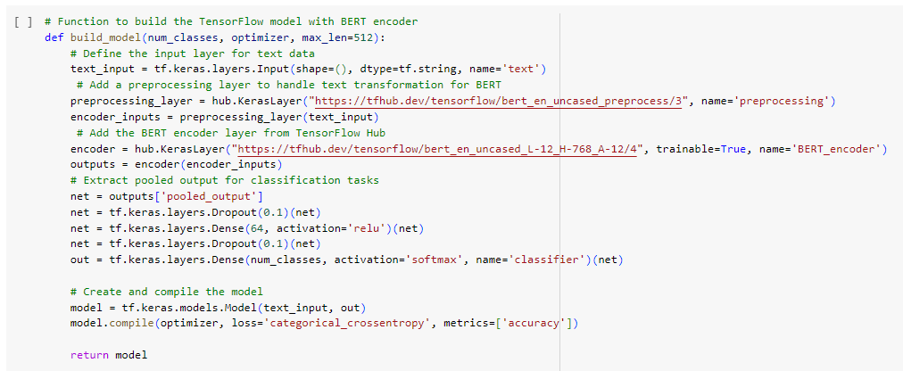
Bert
5
The build_model function creates a neural network for text classification using BERT embeddings. It preprocesses text data, applies BERT encoding, and extracts a pooled output. Dropout is used for regularization, followed by dense layers with ReLU activation and softmax for classification.

Slide 6
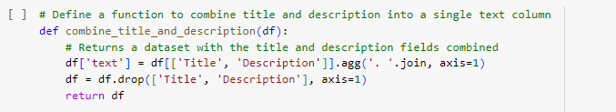
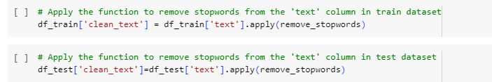
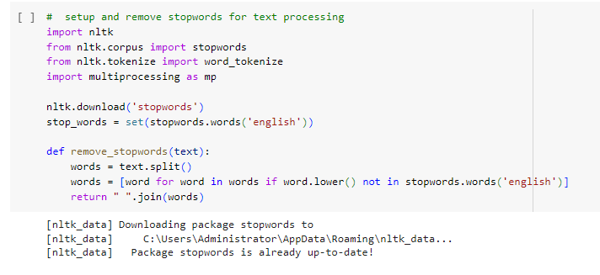
Preprocessing(Bert)
Define Labels, combining title and description, removing stopwords

Slide 7
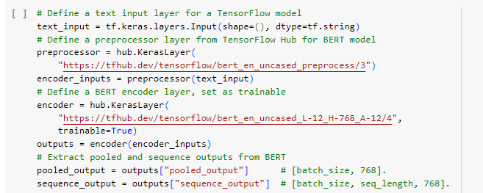
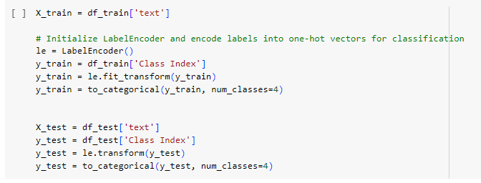
Preprocessing( Bert)
Handle text input, set up a text processing and encoding pipeline using pre-trained BERT (Bidirectional Encoder Representations from Transformers) components from TensorFlow Hub. The code is designed for use in TensorFlow and utilizes BERT to convert raw text inputs into embeddings that can be used for our tasks text classification
LabelEncoder to transform class labels into numerical values.

Slide 8
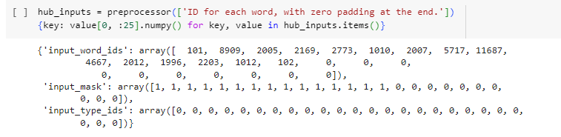
Preprocessing( Bert)
extracting the preprocessed outputs into a dictionary called hub_inputs. Then, it samples the first 25 elements of each value in hub_inputs and converts them into numpy arrays for inspection

Slide 9
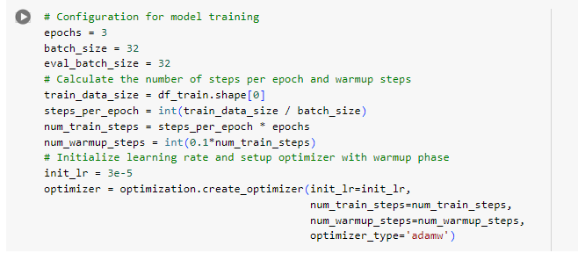
Configuration( Bert)
The epochs is 3 , batch size is 32 and the optimizer used was adamw

Slide 10
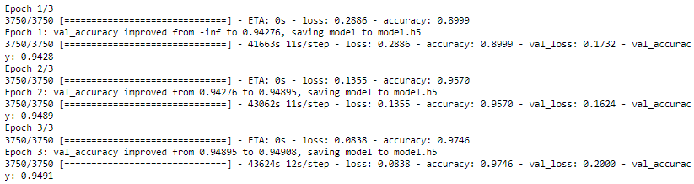
Evaluation Metrics
Bert
Accuracy after 3 epochs

Slide 11
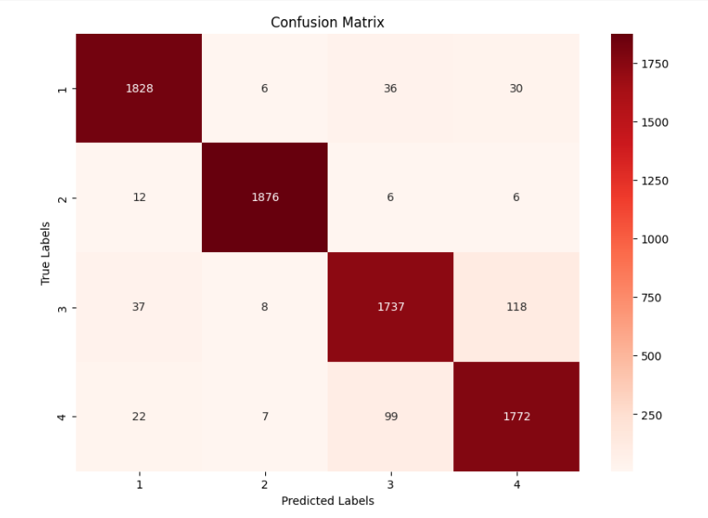
Evaluation Metrics
Bert
Confusion Matrix after 3 epochs

Slide 12
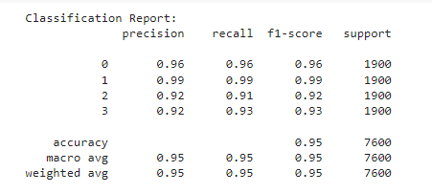
Evaluation Metrics
Bert
Classification report

Slide 13
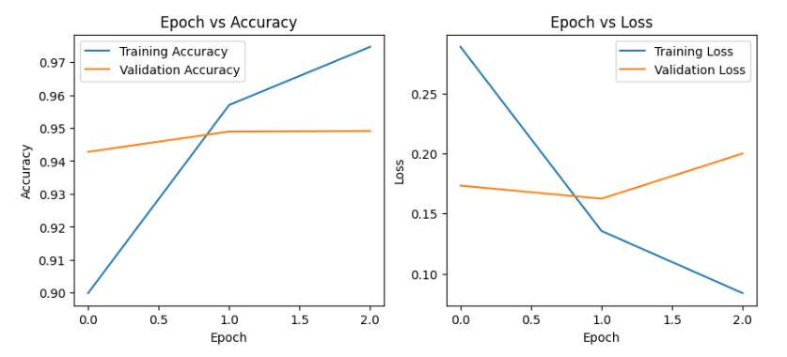
Evaluation Metrics
Bert
Learning curve of 3 epochs

Slide 14
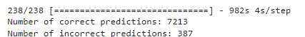
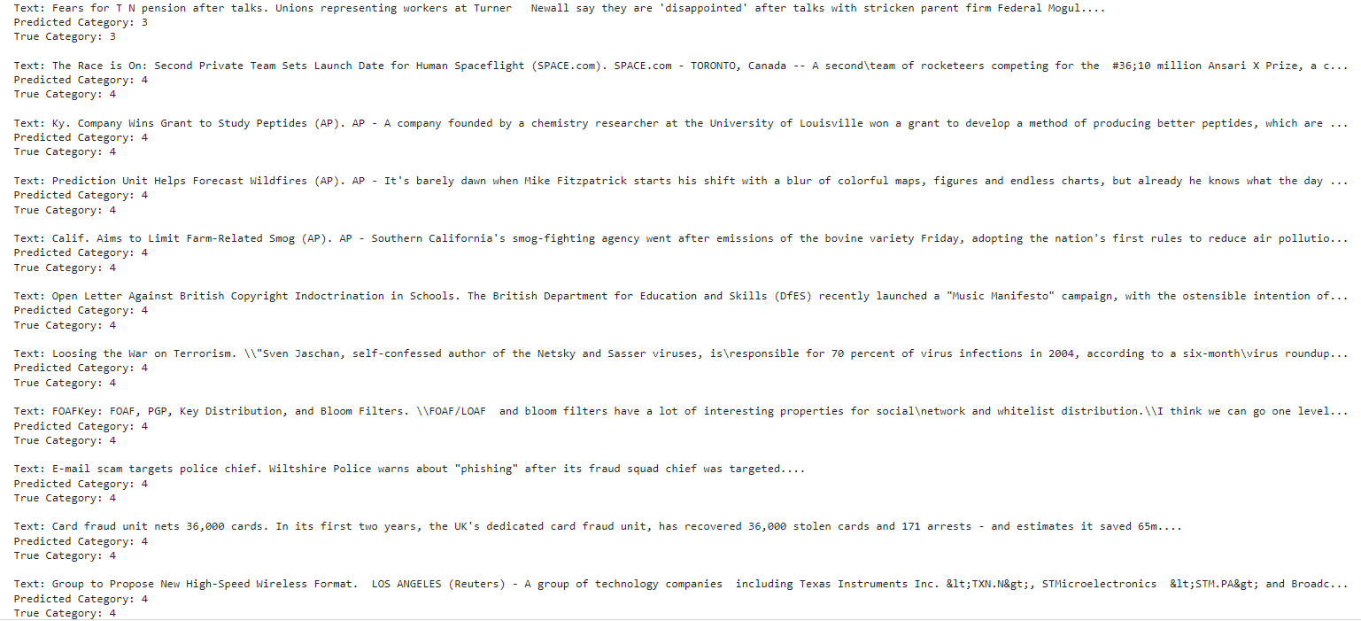
Results
Bert
Model Prediction

Slide 15
DistilBert Model

Slide 16
DistilBert
16
Load the pre-trained distilbert model

Slide 17
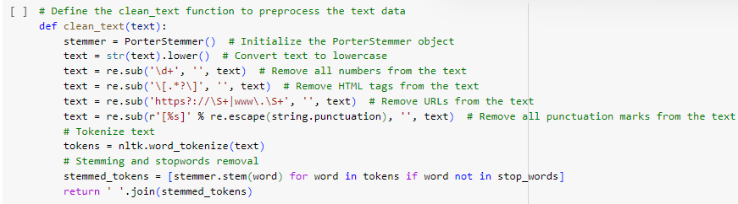
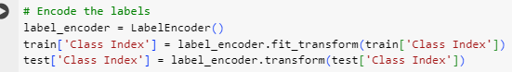
Preprocessing
Distelbert models
The clean_text function preprocesses text data for natural language processing tasks.
This code initializes the tokenizer for DistilBERT, a type of language model.
encode categorical labels into numerical values for both the training and test datasets.

Slide 18
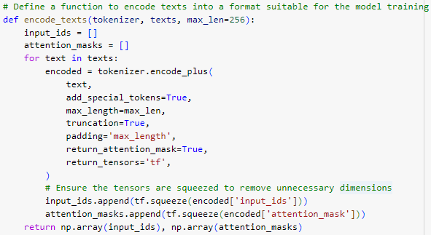
Preprocessing
DistelBert (1st model)
DistelBert (2nd model)

Slide 19
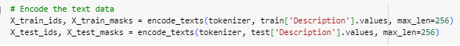
Preprocessing
DistelBert (3rd model)
DistelBert (4th model)

Slide 20
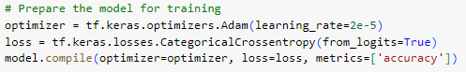
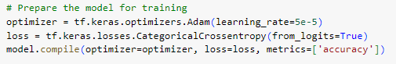
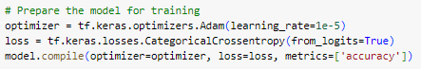
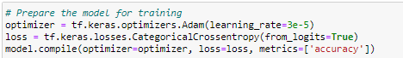
Model variation
DistelBert (1st model)
DistelBert (2nd model)
DistelBert (3rd model)
DistelBert (4th model)
Variation in the learning rate

Slide 21
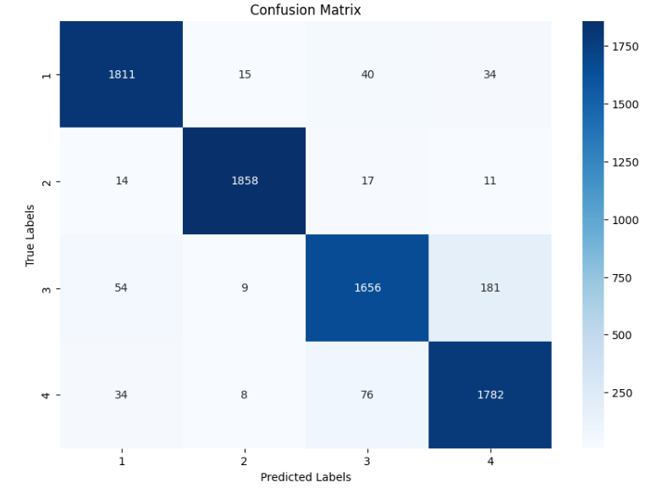
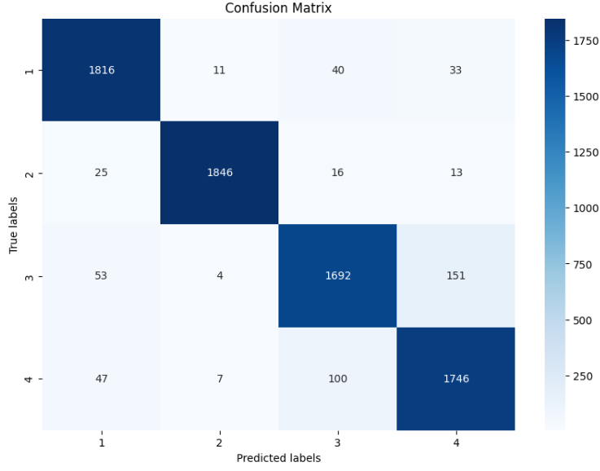
Confusion matrix
DistelBert (1st model)
DistelBert (2nd model)
Confusion Matrix after 1 epoch

Slide 22
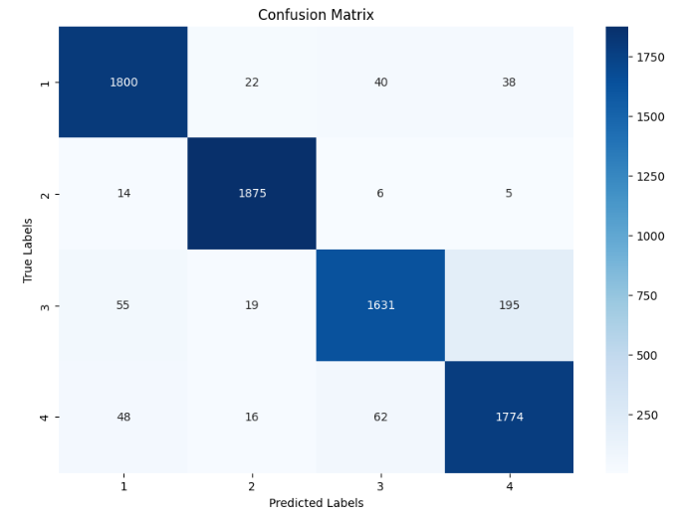
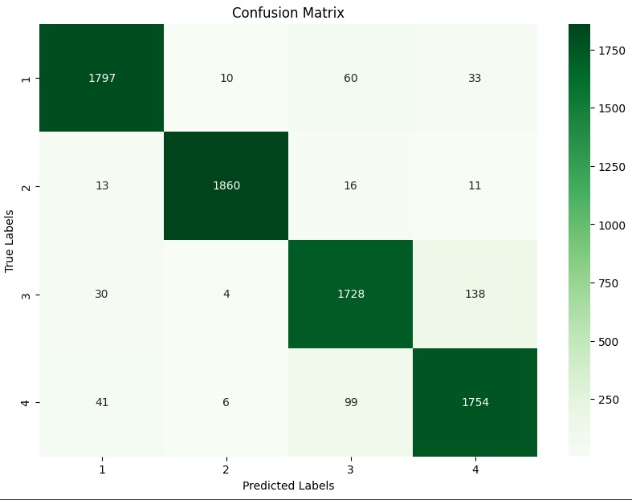
Preprocessing
DistelBert (3rd model)
DistelBert (4th model)
Confusion Matrix after 1 epoch
Confusion Matrix after 3 epochs

Slide 23
Evaluation Metrics
DistelBert (1st model)
DistelBert (2nd model)
Accuracy after one epoch

Slide 24
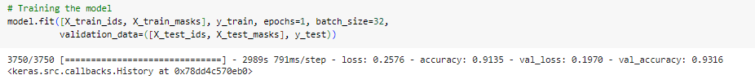
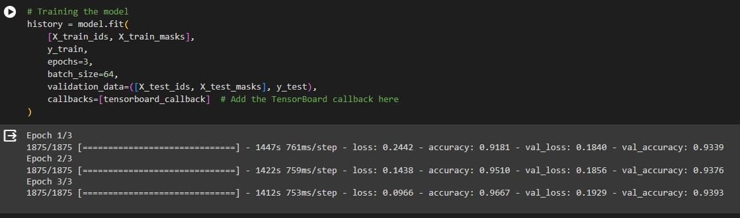
Evaluation Metrics
DistelBert (3rd model)
DistelBert (4th model)
Accuracy after one epoch and 3 epochs

Slide 25
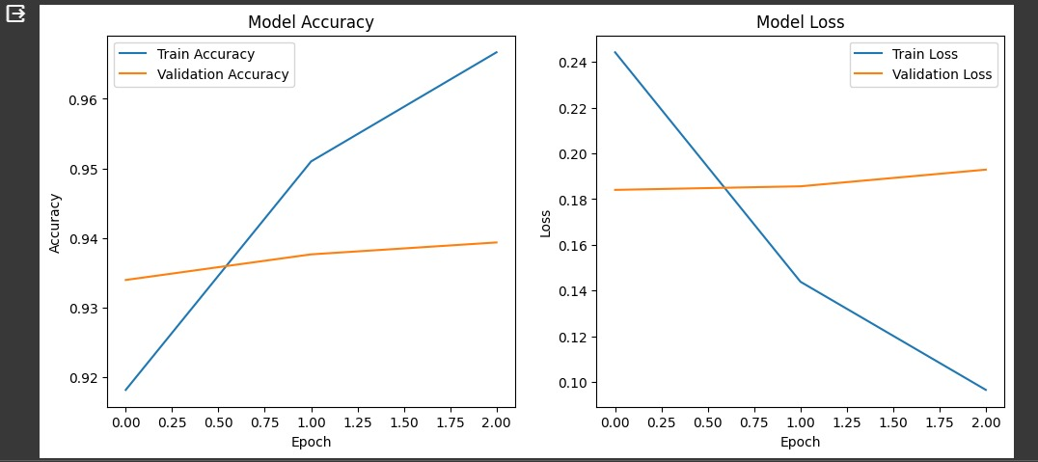
Evaluation Metrics
DistilBert (4th model)
Learning Curve after 3 epochs

Slide 26
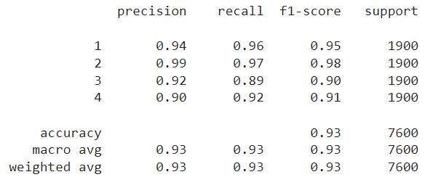
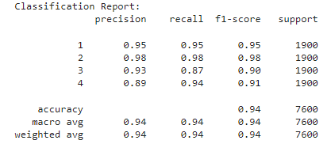
Evaluation Metrics
DistilBert (1st model)
DistilBert (2nd model)
Classification report
Classification report

Slide 27
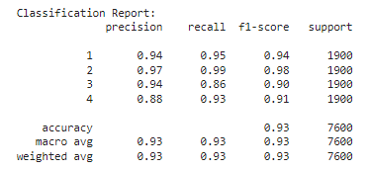
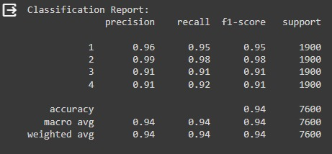
Evaluation Metrics
DistilBert (3rd model)
DistilBert (4th model)
Classification report
Classification report

Slide 28
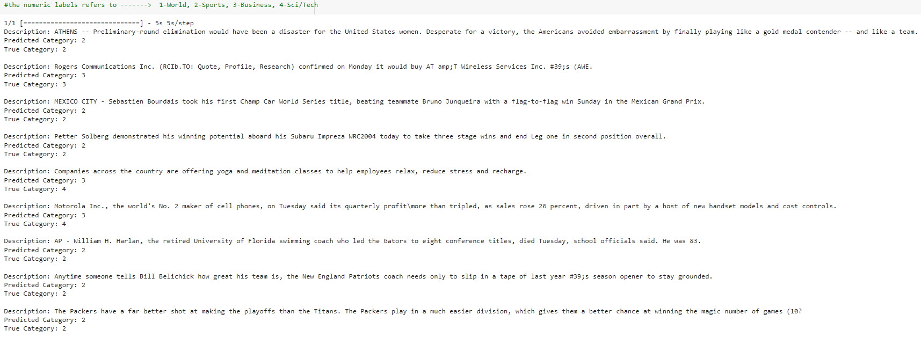
Results
DistilBert (1st model)
Model prediction

Slide 29
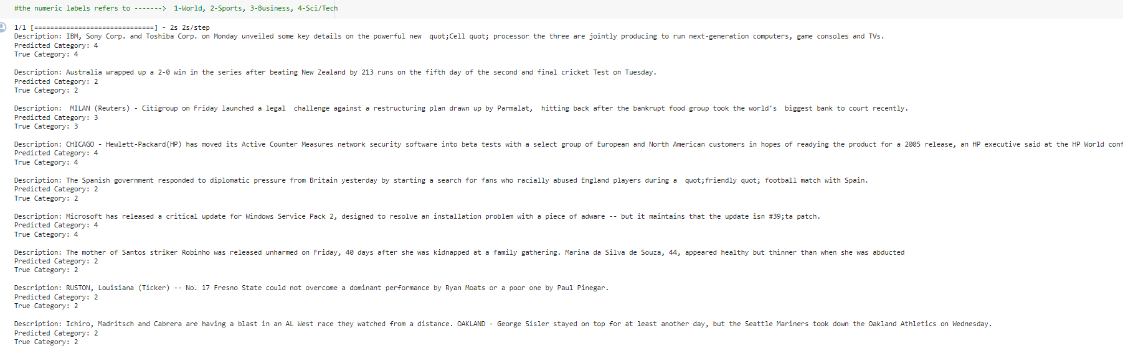
Results
DistilBert (2nd model)
Model prediction

Slide 30
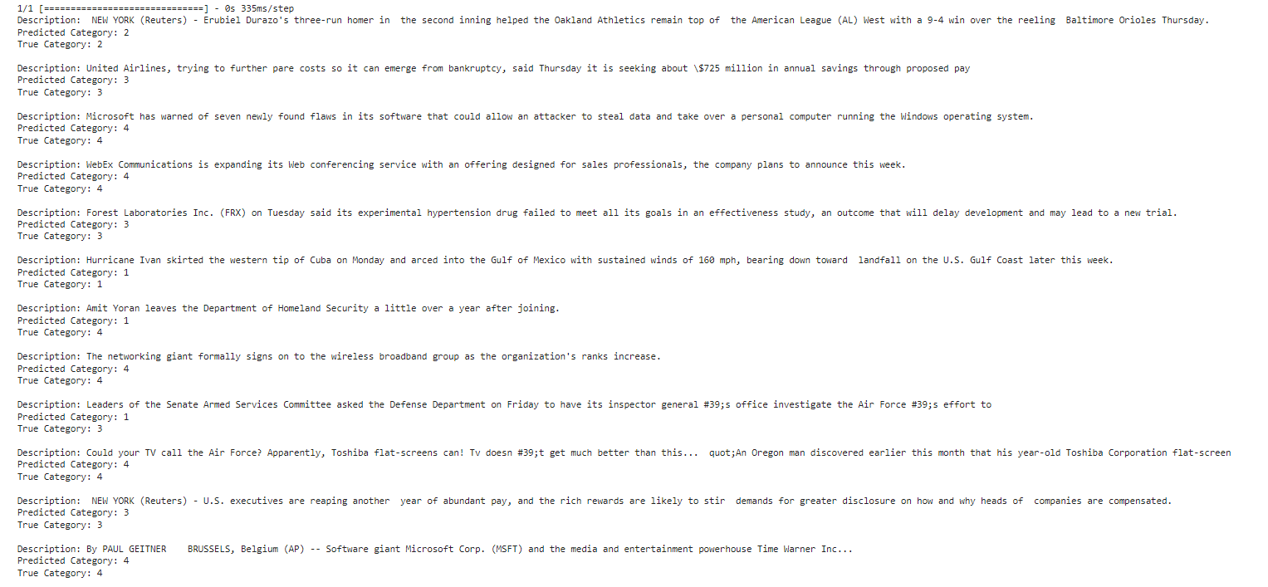
Results
DistilBert (3rd model)
Model prediction

Slide 31
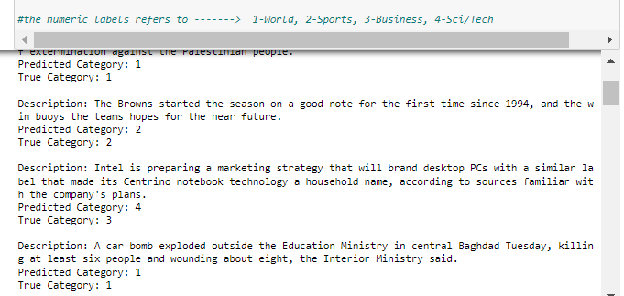
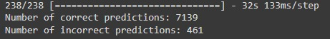
Results
DistilBert (4th model)
Model prediction

Slide 32
Comparison

Slide 33
Classification report comparison
The Models Ranking from Highest to Lowest Based on the based on the accuracy, macro-average precision, recall, and F1-score from the Classification Reports:
Model 5
Model 2 & Model 4
Model 1 & Model 3
Confusion matrix comparison
The Models Ranking from Highest to Lowest Based on the Confusion Matrices:
Model 5
Model 4
Model 2
Model 1
Model 3

